Slide 1
META BANK Banking In The Metaverse
Group 21
Amrit Murdia
Pavan Uppu
Shashi Kant
Sriram Chaitanya
Shariq Nawaz
Tariq Khan
Upendra Kanuru
Notes:
Internet-enabled internet banking. Smartphones enabled mobile banking. Metaverse will enable virtual banking with a more personalized and immersive experience.

Slide 2

Decision Matrix
Critical Assumptions
Prototype
Creative Remix
How did we get to our promising ideas?
How did we arrive at the most promising idea?
What assumptions did we make for Meta-education?
How do our Users feel METABANK in Metaverse?
What are we offering for Gen-Z's Meta-education?
Who?
Who is our end-user?
Current Customer Journey?
How does the bank’s current customer journey feel like? (New and Existing Customers!!)
Ideal Customer Journey?
How should my ideal journey feel like? (New and Existing Customers!!)
Innovation Opportunities!
What are those and why we think they are transformational?
This Photo by Unknown Author is licensed under CC BY-SA

Slide 3
Who?
Main target end user/customer segment
META Bank is looking to enrich the customer onboard experience to attract Gen-Z audience towards bank offerings and to improve the overall consumer banking experience.
META Bank also wants to make sure its existing customer base is well catered, and all their financial needs are fulfilled with delightful experience
Notes:
METABank wants to align to changing market dynamics by engaging in immersive and personalized technology.

Slide 4
How was the innovation opportunity (re)framed after taking a user-centered view of it?

Slide 5
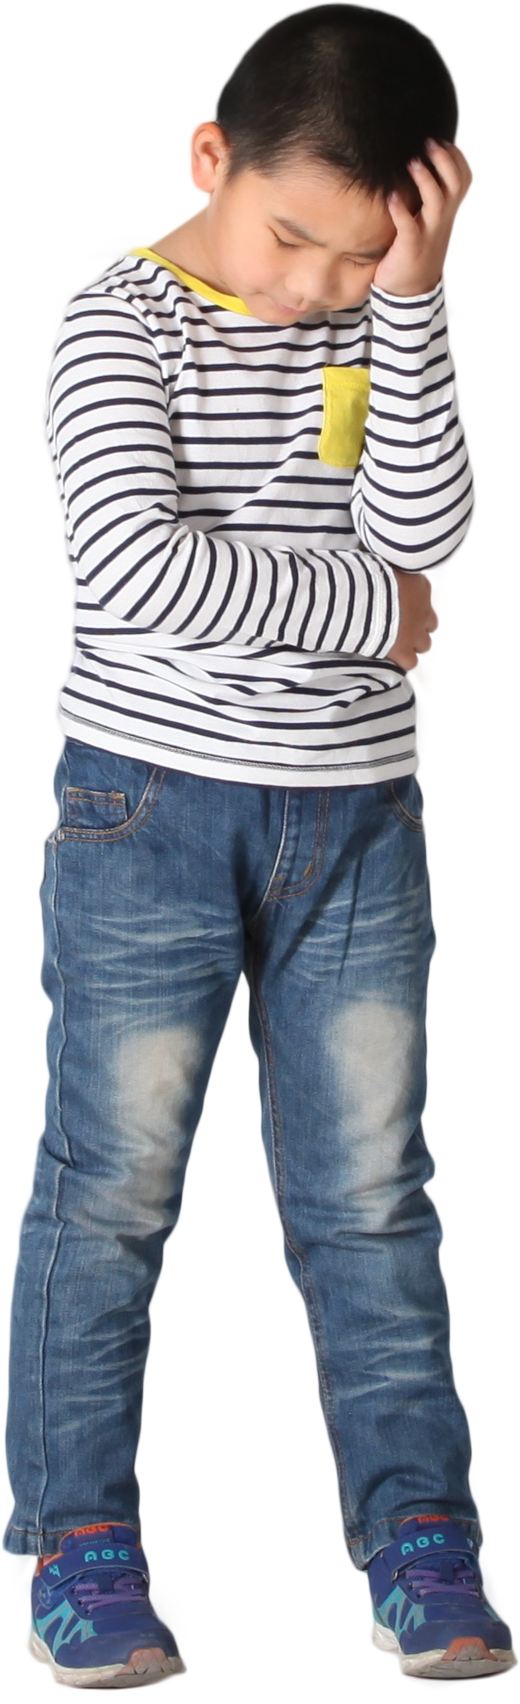



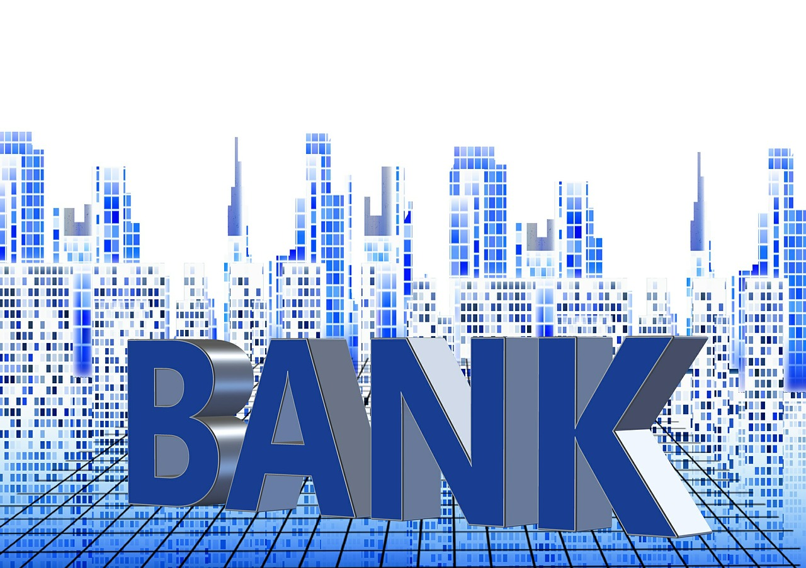

Current Journey - New Customer Onboarding
Research
Visit
Explore
Signup
Leave
"I have to do a lot of research on comparing banks and offerings; have to ask my friends & family"… Phew "Finally narrowed down to METABank – Physical Branch" | "I have to schedule my day so I reach on time before branch closes; have to make sure I leave keeping buffer to commute" | "It's so confusing, and so many offerings" | "Why do I have to carry so many documents for KYC? I am sick of so many signatures and documentation" | "Finally, I am able to open account. However I wish I could get my card with my name printed instantly"
Difficult to understand jargons, fine-prints, too many
offerings
Too many KYC documents difficult to comprehend and carry
Difficult to identify and trust; misinformation on social media
Frustrating to commute to reach in time and wait
Wait for named card to arrive
Google Ads and Personalized Push Notifications for Marketing | Queue management Greets customer for appointment | Provides detailed information | Authorizes and processes transfer and appl Get signature and maintains folders for storage | Hands over package Asks for feedback and service
Notes:
Personalization is NOT a problem in current journey, as its in-person / human touch

Slide 6


Ideal Journey - New Customer Onboarding
Research
Visit
Explore
Signup
Leave
"It was easy to finalize METABank as my preferred bank" | "I am so relieved that I don’t need to commute and worry about bank timings" "Virtual Lounge is so seamless and hassle-free" | "I like the explanation and visualized way of the offerings along with contracts" | "I am impressed by the speed at which my Digitial documents are absorbed for KYC" | "No wonder Digital banking comes with everything instant such as my Digital Wallet"
Hassle-free banking. no need to carry docs; Instant ready to use
Saves time in commute & wait
Easy to comprehend
Instant Wallet
No hassle to research; easy choice
Google Ads and Personalized Push Notifications for Marketing Marketing Metaverse | Assists customer to enter Sends Bonus points | Provides visual way of the offerings and how it is all linked Shares single blanket contracts; smart contracts | Processes documents and store in Vault Walks through customer with set up and services | Keep the vaults transferable Capture feedback for future improvisation

Slide 7
Current Journey – Enhancing existing Customer Experience/Services
Scenario: Customer is interested in Investment Offerings.
*Most pain points from the new onboard experience exists today with the current customers too!
Contact
Explore
Up-Sell/Cross sell
Complete Transaction
"Why should I repeat my need or story each time I call or visit these guys?" | "Why do these guys make me jump cross one specialist to another? Don't they have a checklist and just direct me to the right specialist the first time? | "Why do these guys have to upsell a lot of irrelevant products? Can't they first address what I need? | "Finally, I got what I want! Let me wrap this up and be on my way" "Do I have to carry cash or check book/card always? I feel a bit insecure"
No customer 360degree
view
Too many customer rep interactions
Too much info or Misinformation
Feel Insecure
Authenticates the customer and records the customer need. Each LOB such as mortgage, credit, retail etc., treats the customer the way they recorded in their system. No single view of customer that cuts across LOBs | Ensures the customer is routed to the right specialist where the customers' needs are rightly addressed | Ensures the customer is not missing out on opportunities available in the market. Sometimes customers need help to make the right choice! | Hands over documentation and the process to access the assets digitally or via phone banking Asks for feedback and service

Slide 8
Ideal Journey – Enhancing existing Customer Experience/Services
Scenario: Customer is interested in Investment Offerings.
*Most pain points from the new onboard experience gets addressed with the current customers too!
Contact
Explore
Up-Sell/Cross sell
Complete Transaction
"How seamless it has become to contact agents, when they have my entire info in their front and instant cascading of my concern" | "I don’t need to jump cross one specialist to another any more" | “I got very good info more than what I anticipated. I might buy this new offering which is similar but much better than what I expected!" | "I got what I want in matter of minutes, let me wrap this up and be on my way"
360 degree Customer View
Single customer rep interaction addressing my needs
Accurate product at right time
Money is Invested digitally!
Authenticates the customer and cascades the customer need to all departments. Synchronized treatment of LOB such as mortgage, credit, retail etc. Single view of customer that cuts across LOBs | Ensures the customer is handled by single right specialist where the customers' needs are rightly addressed | Ensures the customer is not missing out on opportunities available in the market. Customer Analytics to gauge what customers need | Hands over documentation and the process to access the assets digitally or via phone banking Asks for feedback and service

Slide 9
What innovative solutions would need to be implemented to address the innovation opportunity identified?

Slide 10
How Might We create financial literacy in the process of onboard?
Gen-Z is learning banking principles from social media influences either from TikTok, YouTube etc.,
How Might We Leverage the existing brand trust of METABANK bank which comes from the traditional banking experience
How Might We create a "Virtual Lounge" to setup the onboard process?
How Might We create a "Hyper-personalized Customer experience" by user centric profile
How Might We setup a personalized financial help using the immersive technology
Create opportunity to offer credit monitoring services
How Might We make the onboard process more fun with some in-games and credits
Credits from the games can be converted into real $ value similar to the credit reward systems.
In-game opportunity to explain regulations and forms that needs signed.
How might we create Smart contracts and introduce to NFT (non-fungible tokens) ?
How might we create a bridge between Fiat currencies vs. Interact with digital currency or event stable coins ?
What innovation opportunities emerge when closing the gap between the ideal and current journeys?

Slide 11





Creative Remix!
Opportunities to Customers Features/ Personas/People/ Company | Earnings | Financial Literacy | Social​ Interaction | Investment​ | Banking Services (such as onboard)
Features
Games​ | Play to Earn Credits/ Cryptocurrency. Credits converts to real Cash | Redirect users to interesting educational videos whenever they get choices incorrectly during the game | Chat or play games with other users in the Lounge (Socialize) | Play games to get more insights on investments (markets, bonds etc.,) | Capability to bring Avatar from other Metaverse – from a favorite cartoon/game
Technology​ | 1) Mining for cryptocurrencies 2) Authenticate blockchain transactions | Direct interaction with Teller/Banker. Avatars! | Merge the interaction with Twitter etc. | 1) Meta-mortgage Program. Purchase property in Metaverse using your METABANK 2) Immersive experience of the Investments w.r.t Market up and Down – Customer would be able to feel and experience how his investments would behave on the Market changes by varying financial parameters​ | OnDemand Gadgets 2) Conversations Authentication/ Authorization/application and service process
Company/ Institutions
Branding/ Marketing | 1) Hash tagging bank customers to invite for raffle draw/ Feedback based credit 2) Cashback for products (oculus/other devices) |  | 1) Social Media presence for METABANK. 2) Customer outreach in Metaverse 3) Reinforce with on-site promotions & imagery via VR kiosks in bank branches | 1) Extend collaborative events such as Quarterly Results/Investors. Q&A backed up by same Financial expertise bank has today | 1) Completing the application process in Metabank you will receive a Virtual wallet, a credit/debit card as an NFT.​ 2) Gradually move customer service to Metaverse​
School/ Employment | What if customers can earn while banking? Beyond credits from the bank | 1) Meta-education courses for High School 2) L&D for current and future employee | Meet-ups and seminars in Metalounge |  | Customers can read into Premium Virtual Magazines, Documentaries, videos.
People
Beast /Joe Rogan |  | Create Interesting Content for customers and educate users | Avatars to answer questions around forms/ documents

Slide 12







Decision Matrix
Selection Criteria | Rewards thru P2E Games | Rewards through raffle draws and cashbacks | Meta-education courses | Meta-mortgage | Voice-based control of transactions
UX/Usability: Is the Feature easy to use, once implemented by the idea?
Resonance with customer: Does the idea relate to customer’s needs?
Resonance with stakeholders: Is the idea beneficial to Investors?
Innovative/ Differentiator: Is the idea noble and serves as an advantage over competition?
Implementable: How easy is the Idea to be implemented?
Long Term Applicability: Is the Feature/Idea sustainable from Institute’s long-term perspective/Goals?
ROI/Commercialization: Is the Idea going to reap ROI soon enough?
Overall Fairing
Customer
Institute

Slide 13
Critical Assumptions – Meta-education
Importance |  | High | Access to high speed uninterrupted internet​ |  |  | User owns a gadget to access METABANK in Metaverse | User onboard to METABANK should be easy | User onboard to METABANK should be easy | ROI: METABANK expects Meta-education pays off after 2-3 years with more product enrollment with Users who went through this program | Amend School curriculum to introduce METABANK in schools | Amend School curriculum to introduce METABANK in schools
 |  |  |  | User understands the basics of digital technology​ | User understands the basics of digital technology​ |  | METABANK and schools need to clear any regulation | METABANK and schools need to clear any regulation
 |  |  | Chatbot to answer basic questions of the User in METABANK |  |  |  |  |  | GEN-Z continues to bank with METABANK and open new accounts across various products
 |  | Medium |  |  |  |  | Gadgets are more user friendly. Easy to carry and easy to use | Gadgets are more user friendly. Easy to carry and easy to use |  | Features in METABANK is easily maintainable | Features in METABANK is easily maintainable
 |  |  | Content should be easy to understand |  |  | Users can easily navigate between games and the banking workflow |  |  | Faster Time to Market: New features in METABANK can be easily released to the users.
 |  | Low
 |  |  | Low |  |  | Medium |  |  | High
 |  |  | Degree of Doubt

Slide 14
How did you (or would you) test the innovation you are proposing?

Slide 15

Prototype! - METABANK and the META-Education
Grab your Gadgets!!
Get to your METABANK!!
MetaBank – Login Screen (marvelapp.com)
Prepare to be Amazed!!

Slide 16


Slide 17
Feedback | Outcomes | Learning
Feedback solicited from TCS INSEAD group and General Public
Channels used –https://marvelapp.com/prototype/j2cda84, Animaker , Microsoft Forms, YouTube
https://forms.office.com/r/7fXhYzUxE2
Logistics
Survey
Increase Content
More interactive videos lecture
Ease of Navigation
People are interested
To experience Metaverse for Learning
To expose Financial literacy at early ages
Pain Areas
Financial Jargons
Commute to Physical Financial Institutions
To Improve
Learnings

Slide 18
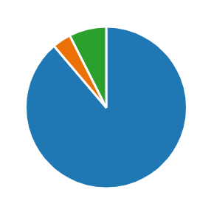
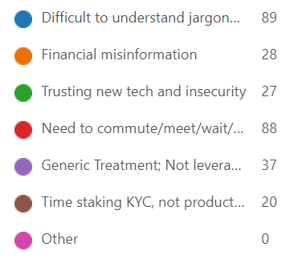
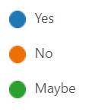
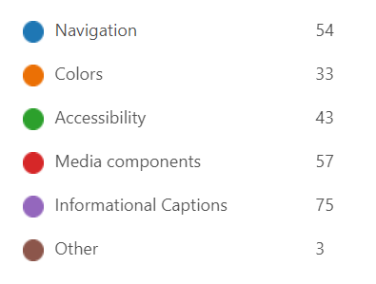
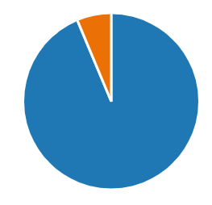
Survey Outcomes
Responses – 111
Average Rating - 2.63/3
What issues, if any, did you face when you visited a physical bank, which could be avoided in Metaverse?
Are you willing to bank in Metaverse?
Would you think introducing Financial Literacy early in the high school / college would help mitigate one of the above issues?
What improvement areas would you like to suggest?

Slide 19
Why would it be a potentially transformational innovation?

Slide 20
Transformation into Metaverse is not about "IF", it is about "WHEN" it will happen!
GEN-Z intuitive and empathetic customer experience would unlock METABANK to unveil hyper-personalized banking products (student loan, auto loan, mortgages, Small business loans etc.,) to the user.
Opportunity to engage with bank more meaningfully instead of "Get it done" perspective.
GEN-Z started to save much earlier than their parents and grand-parents according to a 2021 TransAmerica survey
METABANK wants to capture the early market as they understand the upcoming generation (Gen-Z) has a spending power to reach potential of nearly $60 trillion
METABANK would be the first Company to transact in the metaverse by
Capturing a new market segment of Digital savy - younger generations
Hyper-personalized Customer Experience
Smart Contracts backed by block-chain technology
Immersive Gamification of Complex Banking Systems/Process
Why are your innovation opportunities potentially transformational?

Slide 21
Appendix

Slide 22

# | Questionnaire | Response
1 | Do you have your own bank account? | Yes
2 | If you do, How was your first bank experience? | Confusing
3 | Have you ever visited a bank alone to open a new account? | No
4 | What was your overall experience starting from entering the bank, talking to teller, transacting such as opening a new account, and eventually leaving the bank? | Overall experience is not good. 1. No queue system 2. Generic forms to be filled on paper. No kiosks in certain branches. 3. Banker highlighted the boxes that needs filled and rest was asked to be ignored. No further explanation given. 4. Need to carry original documents for KYC. 5. Fill another form for initial deposit. 6. Sign few forms. No explanation provided. 7. Indicated account will be created after further validation. 8. Took few days for receipt and few more days for a debit card to arrive
5 | Do you like the current banking system? | Not to the extent it offers services for consumer banking
6 | What issues, if any, did you face when you visited a bank? | 1. Users complained of a fact there is no token based – first-cum-first-serve basis in certain local branches vs. Main branch. 2. Users issue to revisit the bank due to missing documentation for KYC which was originally missed by the banker. 3. Users were not clear on all forms which they filled. Some were scanned and some weren't. Not clear on the process the next time they need to visit for similar exercise.
7 | How do you feel about your phone banking or net banking experience if you ever used? | 1. Users reported Satisfactory but recommended multiple improvements in the UX 2. Users complained how the websites/apps are cluttered with ads, selling products, 3. Some products such as transacting via NEFT, IPMS are ok to manage. Some services like WIRE was not clear
Interview the Target User - GEN-Z
Group21 contacted 3 Gen-Z users around same age group and from same geography (India)
User insights are expressed in the form of questionnaire below.
Responses have been generalized for the purpose of presentation

Slide 23
# | Questionnaire | Response
8 | Do you understand metaverse? | All users reported yes
9 | Do you know how cryptocurrency works? and do you own it? | Users understand how crypto works. Some used Coin base to buy some few stable coins
10 | Do you own any cryptocurrency? - (btc, eth, sand, mana etc) | Btc (mostly)
11 | Have you watched VR videos/movies or played games? Do you own VR headset? | Most of the users experienced VR and augmented reality via smart phones. None of the user's own VR headset due to cost factor
12 | Imagine a bank in same scenario where you can just enter a bank by putting on a headset and your avatar will enter the bank; Do you think that is exciting? | All users reported exciting. However, they were usure how feasible it is with the hardware.
13 | Given an opportunity, will you open a bank account in metaverse bank just to experience the technology? | All users reported yes
14 | If banking in metaverse will be very easy to handle, will you still own a bank account in normal(physical) bank? | Users are ok with the idea a physical bank offering a version of banking via Metaverse. Users are completely not sure if they would only bank with a metaverse bank. Users still believed in big and traditional banks offering services.
Interview the Target User - GEN-Z
Interview the Target User - GEN-Z (Contd..)

Slide 24
References
Insights from Metaverse in Banking https://www.accenture.com/us-en/insights/banking/consumer-study-making-digital-banking-more-human https://www.accenture.com/ch-en/insights/banking/global-banking-industry-outlook https://bankingblog.accenture.com/ultimate-guide-to-banking-in-the-metaverse JP Morgan is first bank to enter the metaverse with a virtual ‘Onyx lounge’ Bank of America is First in Industry to Launch Virtual Reality Training Program in Nearly 4,300 Financial Centers HSBC moves into the metaverse https://www.thehindubusinessline.com/money-and-banking/union-bank-launches-metaverse-virtual-lounge-andopen-banking-sandbox-environment/article65616081.ece
Insights on What Gen-Z wants from banking https://thefinancialbrand.com/news/gen-z-banking/top-gen-z-trends-impacting-banking-2022-127233/ What do Gen Z consumers want from financial institutions? | NCR Banking Primer

Slide 25
Prototype Feedback Survey
1.Are you willing to bank in Metaverse?Required to answer. Single choice.
Yes
No
Maybe
2.What issues, if any, did you face when you visited a physical bank, which could be avoided in Metaverse?Required to answer. Multiple choice.
Difficult to understand jargons and fine-prints, too many offerings
Financial misinformation
Trusting new tech and insecurity
Need to commute/meet/wait/lack of personalization
Generic Treatment; Not leveraging customer info
Time staking KYC, not productive, heavy T&C
3.Would you think introducing Financial Literacy early in the high school / college would help mitigate one of the above issues?Required to answer. Single choice.
Yes
No
4.Pls rate your experience of Metaverse using the Mobile App in terms of intuitiveness and conceptRequired to answer. Rating.
5.What improvement areas would you like to suggest?Required to answer. Multiple choice.
Navigation
Colors
Accessibility
Media components
Informational Captions
6.Any other comment / feedback

Slide 26

Prototype! - Agile Iterating
Iteration1
Iteration2
Iteration3
Rudimentary low fidelity prototype with static user actions
Less Engaging
Improvised user engagement
Feedback incorporated from I1
Better user flow and easy to follow
Enhanced Functional and Intuitive prototype using sophisticated tools
Mindful & Marketable

Slide 27
Promising ideas
Meta-ducation courses for High School:
This will be designed for high school kids where they must live in metaverse and they will get paycheck and they must manage their own house, own vehicles, pay bills, manage their funds, loans and investments. In short, they will learn real world problem in in a hypothetical world of metaverse.
L&D Employee Training:
Every employee to have hands on exp to help customer in this new world.(Employment+Learning)
Play to Earn Games:
A crypto based game to create and earn valuable digital items that can be sold to generate income. Metabank will develop its own NFT called M-NFT which can be traded with fist currency via an exchange provided by Meta bank.

Slide 28
Promising ideas
Hash-Tagging to lure for Meta versing :
Customers who are banking, are motivated to continue using Metaverse by tagging them to be invited for Raffle draws or credits
Cashback for Products:
This will encourage connectivity for Metaverse by providing Cashback for products (oculus/other devices) bought through bank cards

Slide 29







Promising Ideas
Authentication/Authorization
Application Form
Consent Form
Deposit/Withdrawals
Exchange
Conversational
Investment Services

